Slide 1
Ansible Automation
Hands On / Deep Dive

Slide 2
Presenters
Dan Burkland and Tim Knipper

Slide 3
Presenter Contact Information
Dan Burkland
Senior Data Center Architect
Minneapolis, MN
Dan.burkland@insight.com
(763) 498-3646
Tim Knipper
Senior Solutions Architect
Des Moines, IA
Tim.knipper@insight.com
(515) 661-2998

Slide 4
Agenda

Slide 5
Agenda
Introductions
Automation tools used in this session
Why Automation
Configuration Management vs Infrastructure as Code
Automation Tool Overview
Demos
Hands On Deep Dive with Datalink Innovation Hubs
Questions and Follow-up

Slide 6
Automation tools used in this Session

Slide 7
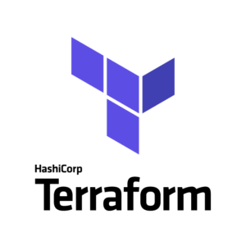

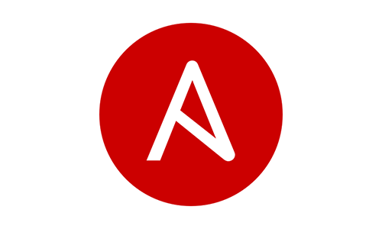
Automation Tools
Docker
Ansible
Terraform

Slide 8
Why Automation

Slide 9
Why Automation
Consistency across environments
Avoid configuration drift as standards change over time
Ability to repeat common tasks
Desire for known outcomes
Simplicity (think multi-hybrid cloud)
Reprioritization of resources (delegation of day-to-day)
Auditable and versioned infrastructure

Slide 10
Configuration Management vs Infrastructure as Code

Slide 11
Configuration Management vs Infrastructure as Code
Configuration Management
Config Management is the governance and systems engineering process for ensuring consistency of physical and logical assets in an operational environment
Common Tools include:
Ansible**
Chef
Puppet
Salt
Common use cases include:
Config file management on compute and networking equipment (ex. /etc/ssh/sshd_config)
Advanced configuration of new solutions (e.x. NetApp 0-day, Kubernetes deployment, Networking 0-day)
Patch and package management for compute equipment
Security auditing

Slide 12
Configuration Management vs Infrastructure as Code (Cont.)
Infrastructure as Code
Infrastructure as Code is the process of managing and provisioning computer datacenters through machine-readable definition files, rather than utilizing physical hardware configuration and/or interactive configuration tools.
Common Tools include:
Amazon AWS CloudFormation
Azure Resource Manager
Google Cloud Deployment Manager
Terraform**
Common use cases include:
IaaS stack deployments in both public and private clouds (ex. Creating VMs)
Immutable infrastructure
Testing and versioning of infrastructure

Slide 13
Automation Tools Overview
Docker / Ansible / Terraform

Slide 14
Docker Overview
Packaged Ansible & Terraform into single docker image
Based on latest upstream CentOS 7 image (w/ latest updates)
Portable
Runs on any x86-based Docker host
Contains all dependencies (libraries)
Flexible - Can be given access to directories on host system

Slide 15
Ansible Overview
Agent-less
Uses SSH or WinRM
Opensource (owned/maintained by Red Hat, now IBM)
Built on Python
Scripts are known as playbooks
Playbooks are declarative and based in YAML
Vendor-specific libraries are known as modules (Cisco, NetApp, Pure Storage, VMware, etc)
Re-use code via templates and roles (think functions)
Credential / Password database exists and is known as Ansible Vault

Slide 16
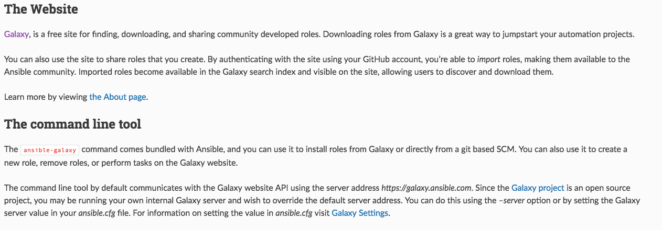
Ansible Overview (Cont.)

Slide 17
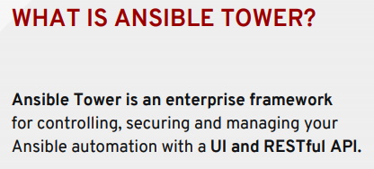
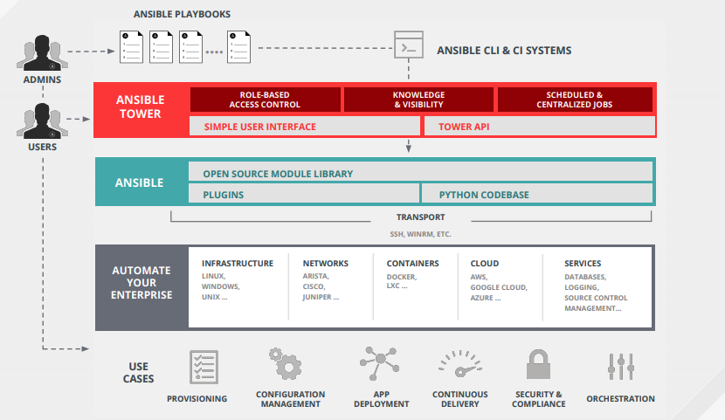
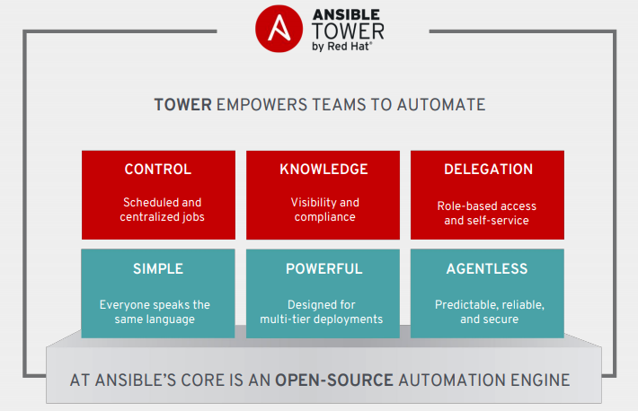
Ansible Tower

Slide 18
Ansible Best Practices
Build functions into streamlined “roles”: so they can be reused across playbooks
Variables and playbooks should be separated into different files
Do NOT store credentials as plain-text variables (leverage Ansible Vault instead)
Leverage facts when dynamic variables are needed
Utilize vendor-specific modules as much as possible and restrict use of command, raw, and shell modules

Slide 19
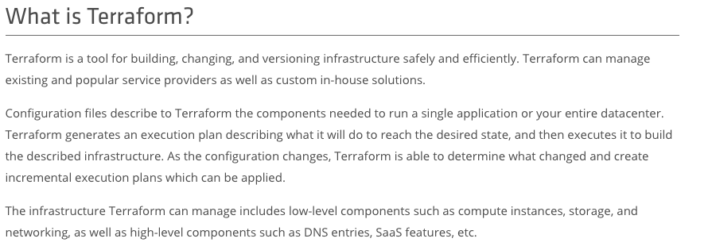
Terraform Overview

Slide 20
Terraform Overview (Cont.)
Agent-less
Leverages public Cloud Provider APIs
Leverages vCenter API for private cloud
Opensource (owned/maintained by Hashicorp)
Built on Go Language
Terraform files are declarative and based in HCL (Hashicorp Command Language) which is similar to JSON.
Vendor-specific libraries are known as modules (GCP, AWS, Azure, Openstack, VMware, etc)
Re-useable code (Dynamic and Static Variable definitions)
Credential / Password database exists and known as Hashicorp Vault
Enterprise Solutions Available to get support and integration

Slide 21
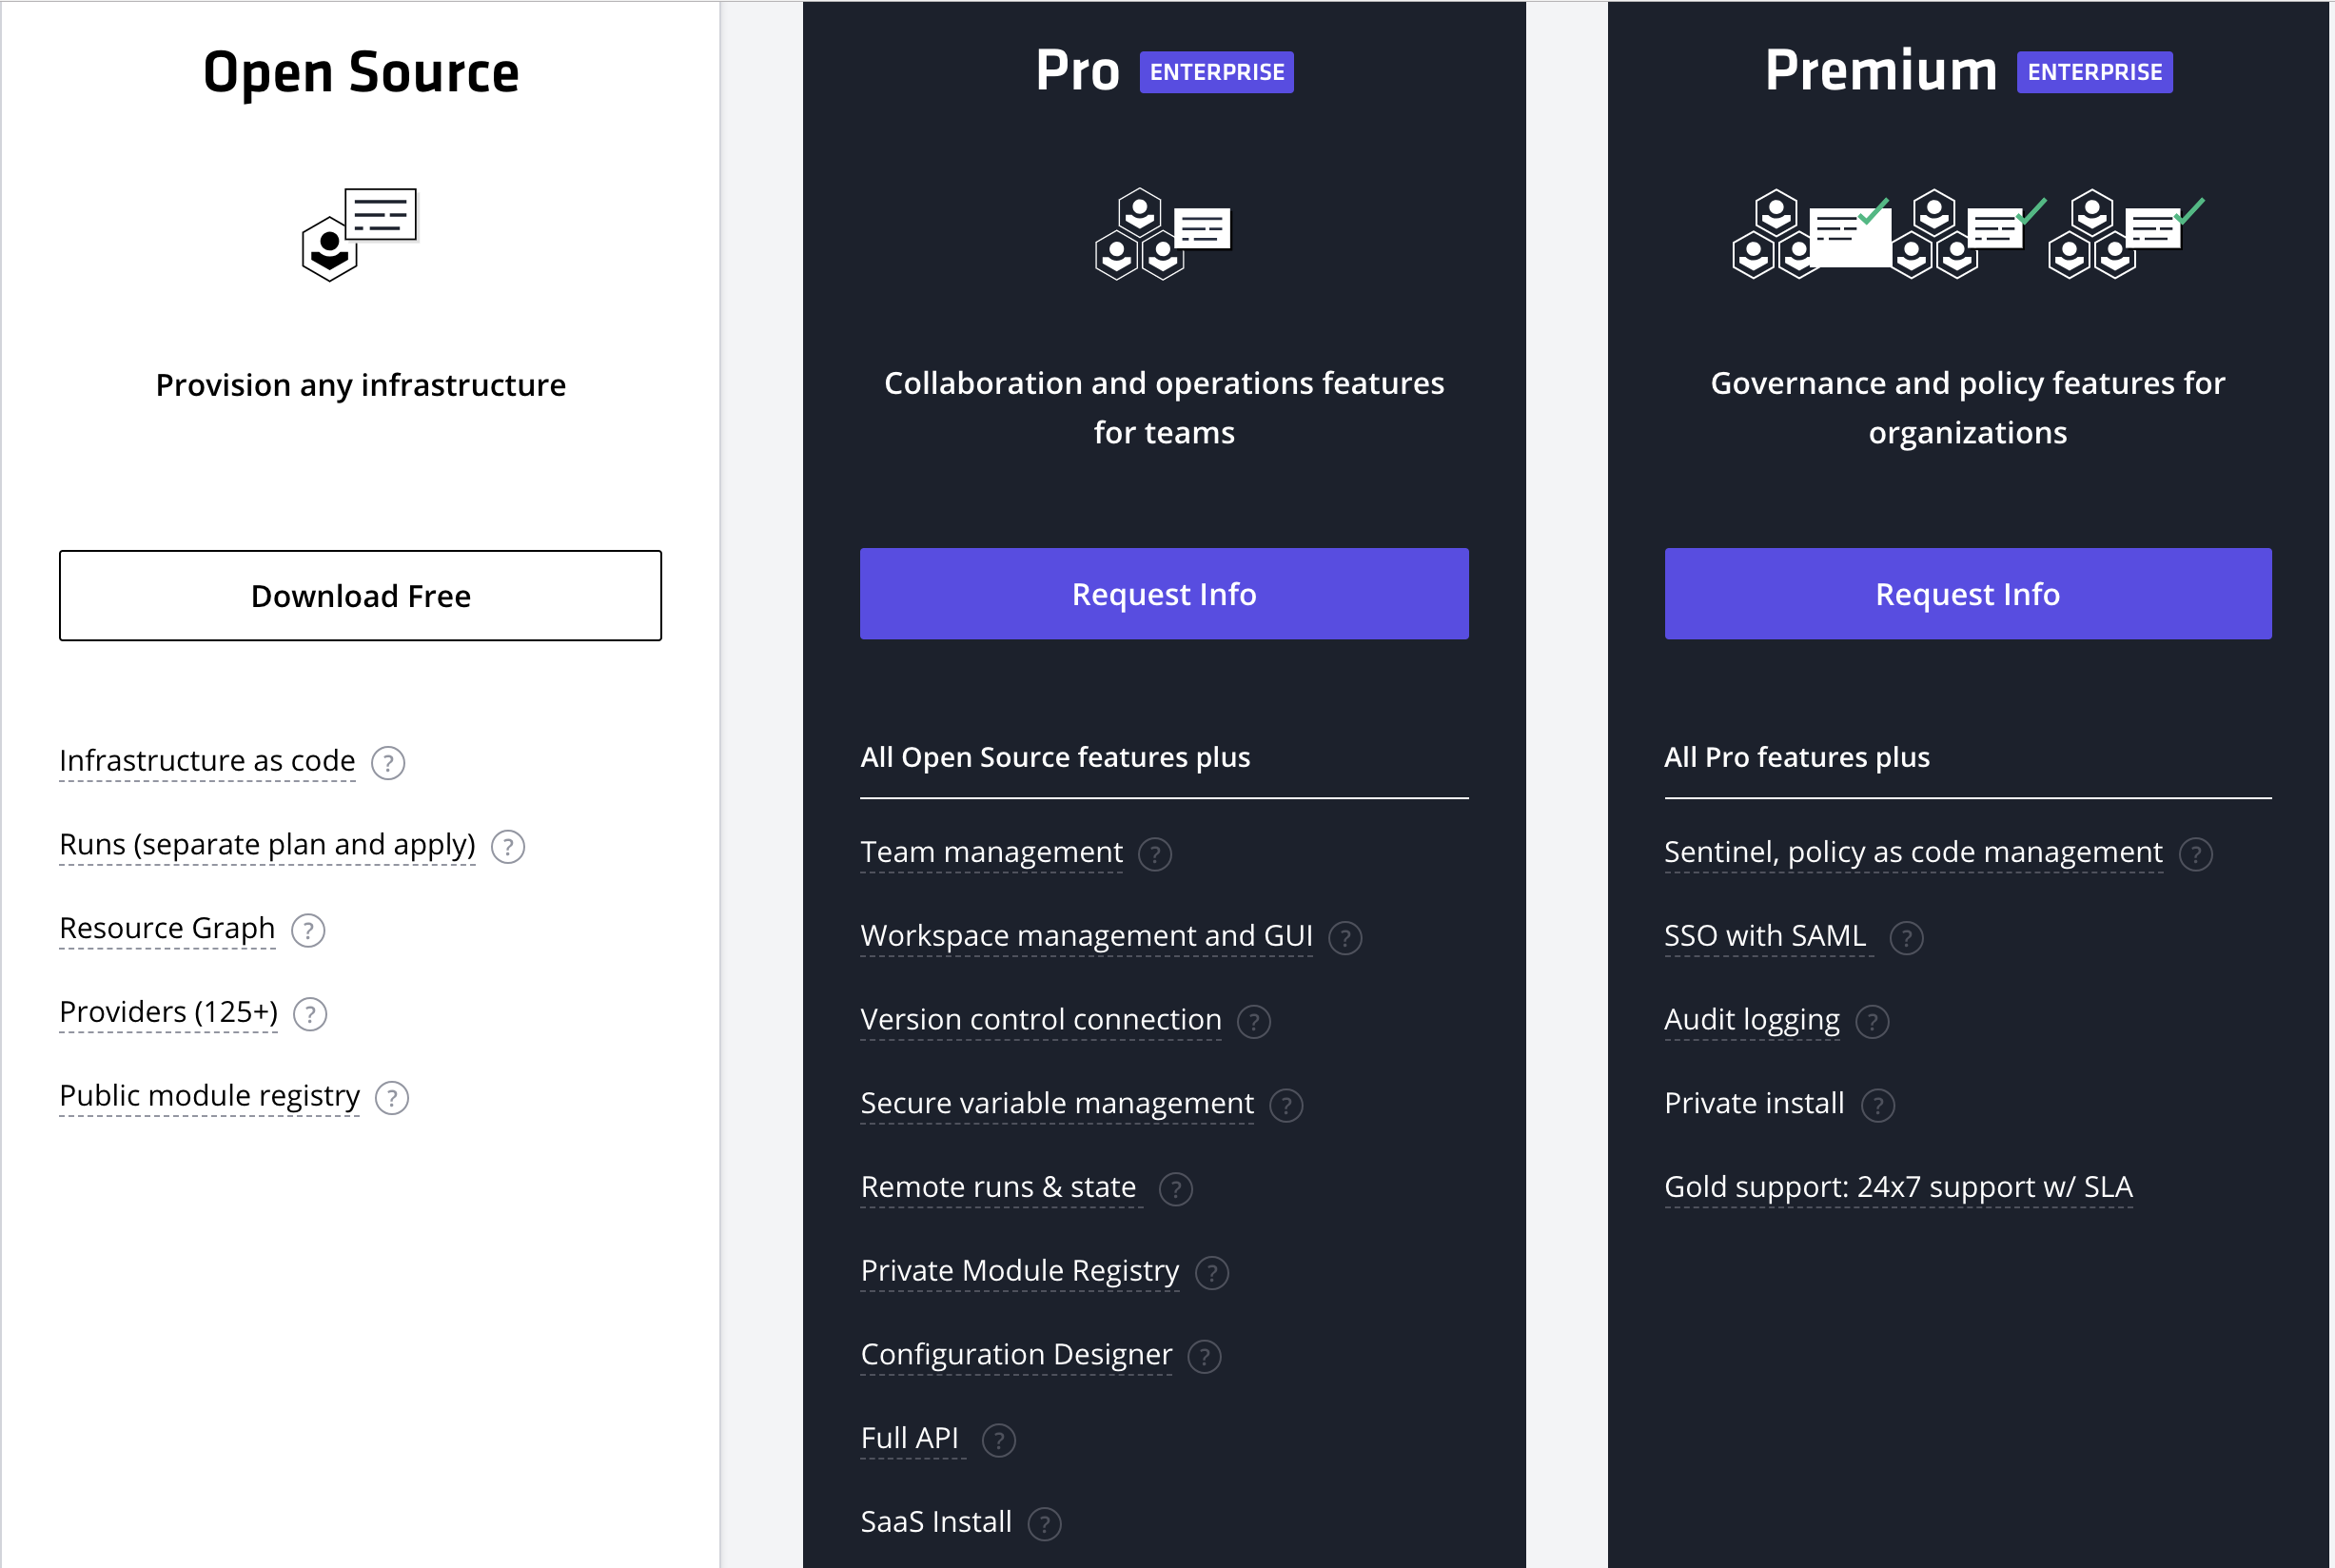
Terraform Versions

Slide 22
Terraform Best Practices
Leverage separate directories and/or workspaces to ensure infrastructure separation (prod/dev or application/stack)
All or nothing approach (tool fragmentation creates complexity)
Take remote state seriously - Centralize Terraform or purchase Terraform Enterprise or Terraform Pro
Ensure agreed upon framework for variable, environment variable (.tfvars), and main (.tf) files

Slide 23
Demos

Slide 24
Ansible - Networking Demos
IOS/NXOS Demos
Adding a VLAN to an existing network using IOS/NXOS modules and config modules
Doing a config Diff to see changes
ACI
Adding a user
Adding a Bridge Domain
Adding an EPG
Restful API configuration when no specific module available
Calling multiple smaller roles from a single playbook
ACI Interface Policies
Adding an entire VLAN from a Network Centric Point of View

Slide 25
Ansible - Storage Demo
NetApp ONTAP - 0-day NetApp Setup & Configuration
Cluster
Temporarily enables HTTP API access
Cleanup existing configuration*
Basic cluster configuration
Node
VLAN configuration
Ifgrp configuration
Set MTU
Configure SPs
Configure ASUP
SVM
Create data SVM(s)
Full SVM configuration (data serving at the end)

Slide 26
Hands on Deep Dive with Datalink Innovation Hubs
Verify you can connect to the Lab VPN
Open up the Cisco AnyConnect client on your workstation
Connect to vpn.datalinklabs.com
Use your Lab Active Directory credentials
Browse to https://tinyurl.com/insightengsummit-ansible for the detailed lab guide
Raise your hand if you run into any issues

Slide 27
Terraform Demo
Create 4 Linux VMs based on RancherOS (think Kubernetes)

Slide 28
Questions, Discussion & Follow-up

Slide 29
Thank You

Slide 30
Addendum

Slide 31
Resources
Ansible Galaxy
https://galaxy.ansible.com
Ansible Module Index
https://docs.ansible.com/ansible/latest/modules/modules_by_category.html
All files from this session
https://github.com/dburkland/insightengsummit_ansible_session

